Slide 1
Stack & Queue
Data Structure & Algorithms

Slide 2
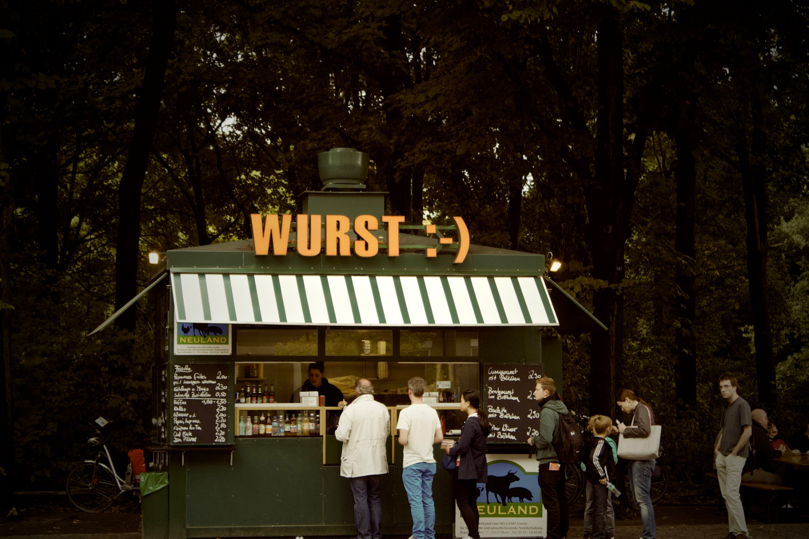
QUEUE
Queue:( Hàng đợi ) là một cấu trúc dữ liệu hoạt động theo nguyên tắc FIFO ( First In First Out ) - VÀO TRƯỚC RA TRƯỚC

Slide 3

STACK
STACK - NGĂN XẾP : FILO ( FIRST IN LAST OUT : VÀO TRƯỚC RA SAU )

Slide 4
APPLICATIONS - ỨNG DỤNG STACK & QUEUE
> QUEUE - HÀNG ĐỢI : Breadth First Search ( BFS ) algorithm, …
> STACK - NGĂN XẾP : Depth First Search ( DFS ) algorithm, …

Slide 5
Implement - cài đặt
Các thao tác chính :
> push : Thêm một phần tử vào SoQ
> pop : Lấy một phần tử từ SoQ
> isFull : Kiểm tra SoQ đã đầy chưa
> isEmpty : Kiểm tra SoQ rỗng hay không

Slide 6
Implement - Cài đặt
1
5
4
3
2
1
2
3
4
> Array : Sử dụng một mảng array để làm buffer cho stack & queue
Head
Tail
Top
Queue - Hàng đợi
Stack - Ngăn xếp

Slide 7
Implement - Cài đặt
> Array : sử dụng 1 mảng array làm buffer cho Stack & Queue
public class MyQueue{
private int[] array;
private int SIZE;
private int head;
private int tail;
MyQueue(int size){
array = new int[size];
SIZE = size;
}
}
public class MyStack{
private int[] array;
private int SIZE;
private int top;
MyStack(int size){
array = new int[size];
SIZE = size;
}
}

Slide 8
Implement - Cài đặt
> Sử dụng linked list để lưu trữ stack & queue
4
topNode
head
tail
4
3
2
1
3
2
Hàng đợi : queue
1
Ngăn xếp : stack

Slide 9
Implement - Cài đặt
> Array : Sử dụng một mảng để làm buffer cho Stack và Queue
Ưu điểm : Dễ implement ( cài đặt )
Nhược điểm : bộ nhớ bị giới hạn và không tối ưu
> Linked list : Sử dụng danh sách liên kết đơn
Ưu điểm : Tối ưu về mặt kich thuoc
Nhược điểm : Implement khó hơn sử dụng array

Slide 10
Tạo interface cho stack & queue
public interface IStackQueue{
public boolean push(int value);
public int pop();
public boolean isFull();
public boolean isEmpty();
public void display();
}

Slide 11
MyStack
public class MyArrayStack implements IStackQueue {
private int[] array;
private int SIZE;
private int topIndex;
MyArrayStack(int size){
SIZE = size;
array = new int[SIZE];
topIndex = -1;
}

Slide 12
MyStack
public boolean isFull(){
return topIndex == SIZE-1;
}
public boolean isEmpty(){
return topIndex == -1;
}
public void display()
if(isEmpty()) System.err.println("Stack is empty!");
else
{
for(int value : array){
System.out.print(array[i] + " ");
}
System.out.println();
}
}

Slide 13
MyStack
public boolean push(int value){
if(isFull()) return false;
array[++index] = value;
return true;
}
public int pop(){
if(!isEmpty()) return -1;
return array[topIndex--];
}

Slide 14
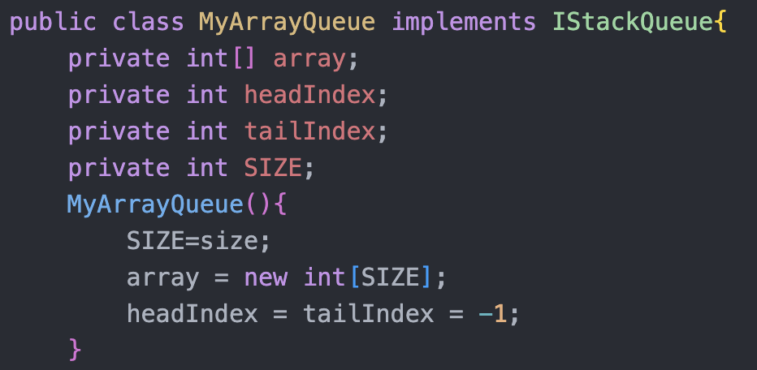
MyQueue

Slide 15
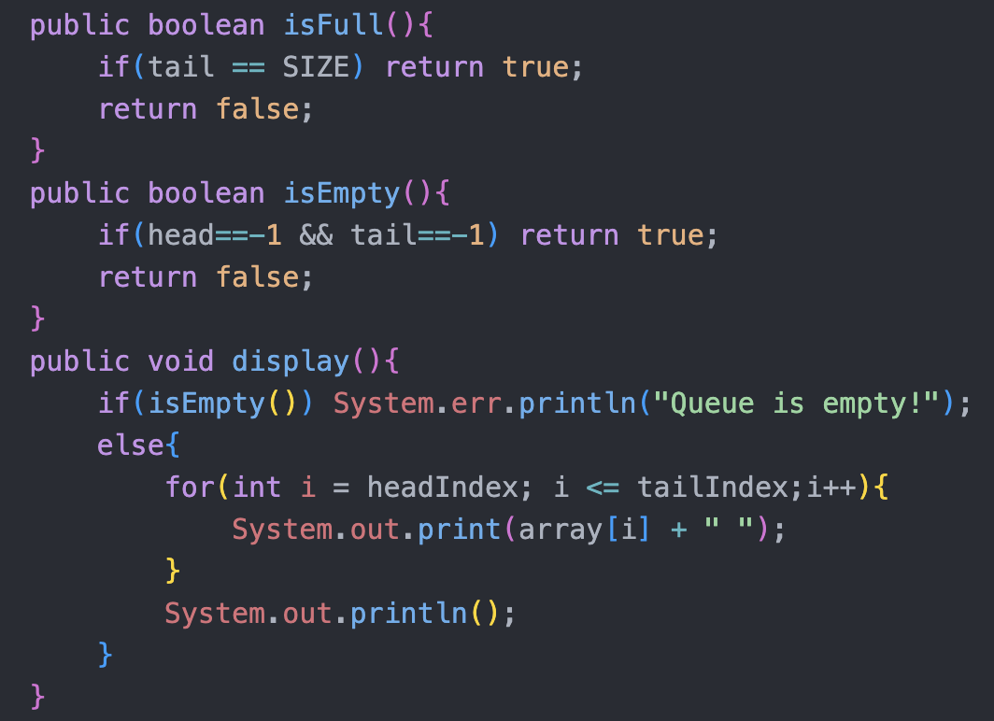
MyQueue

Slide 16
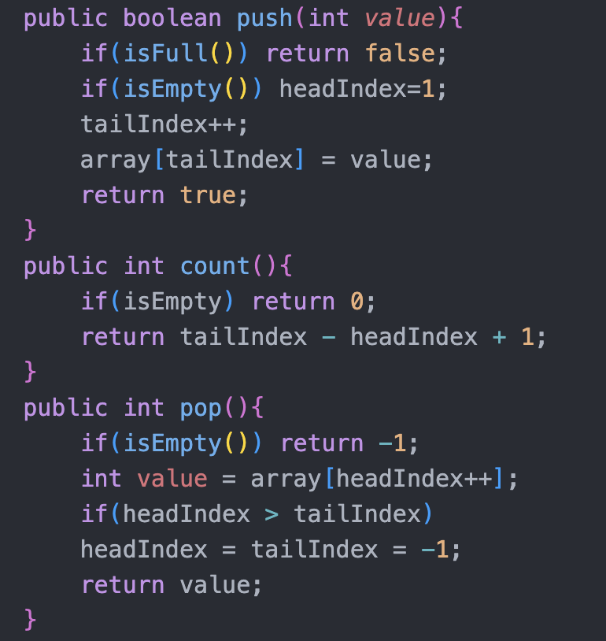
MyQueue

Slide 17
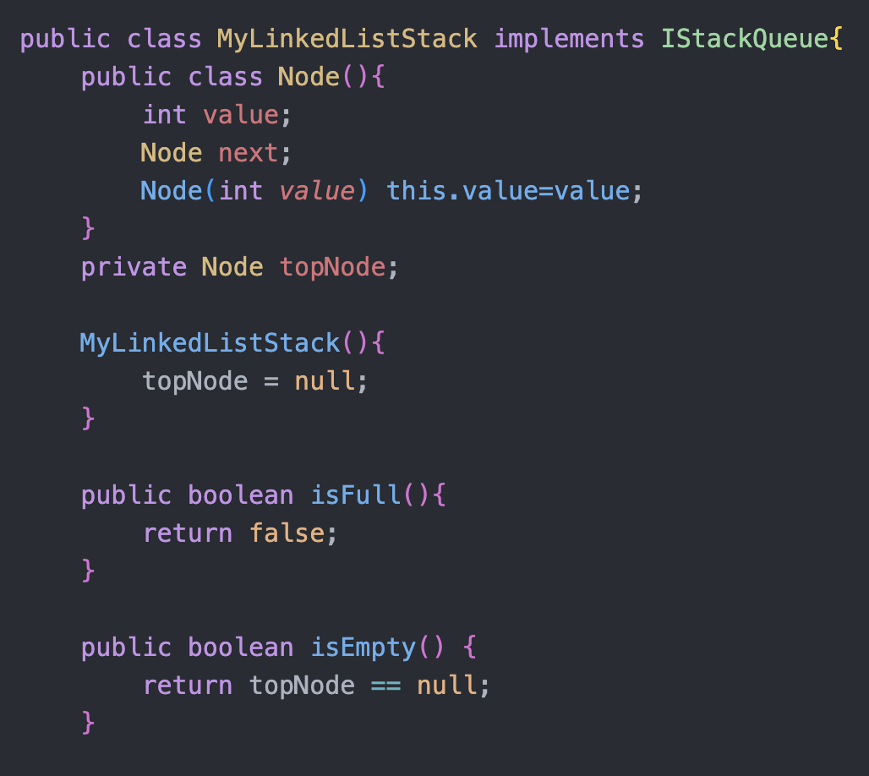
MyLinkedListStack

Slide 18
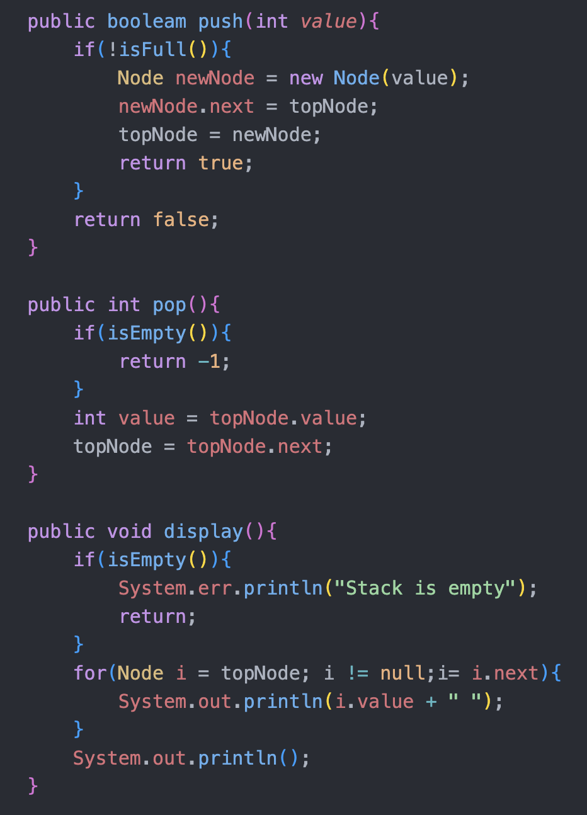
MyLinkedListStack

Slide 19
Recursion ( Đệ quy )
Data Structure & Algorithms

Slide 20
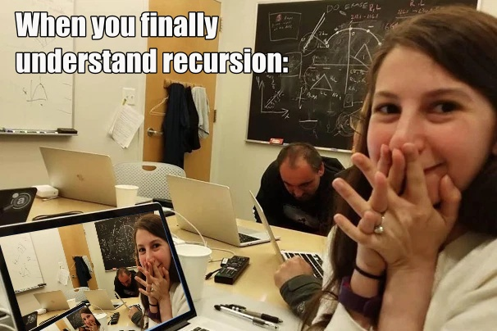
Đệ quy

Slide 21
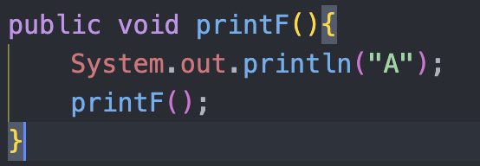
Định nghĩa
> Recursion : Đệ quy là hàm tự gọi đến chính nó.

Slide 22
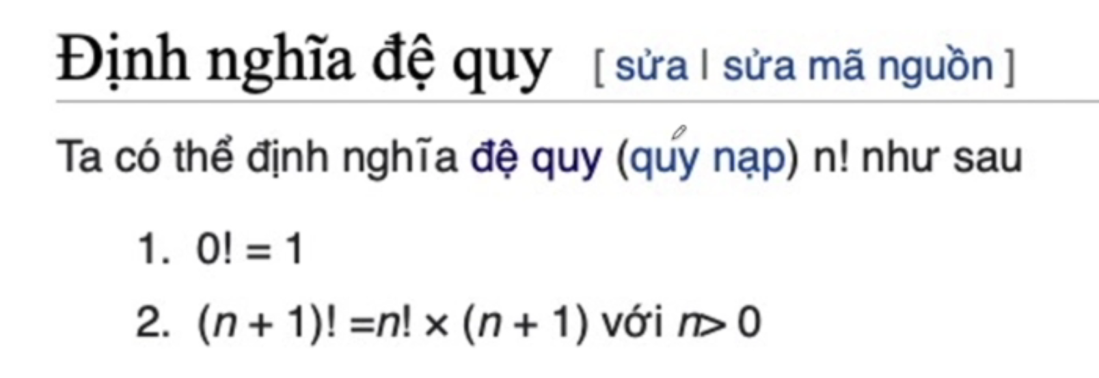
Đặc điểm của đệ quy
> Khi xuất hiện yếu tố đệ quy trong bài toán
Yếu tố đệ quy :
neo ( cơ sở ) / điều kiện dừng
công thức quy nạp - phải đưa về bài toán nhỏ hơn ( cuối cùng là bài toán cơ sở )

Slide 23
Challenges
> Tính giai thừa
> Tính số Fibonacci
> Một số bài toán khác :
> Tính tổng từ 1 + 2 + … + n
> Tính số mũ A^n = A^n-1 * A
> In giá trị của một mảng số nguyên

Slide 24
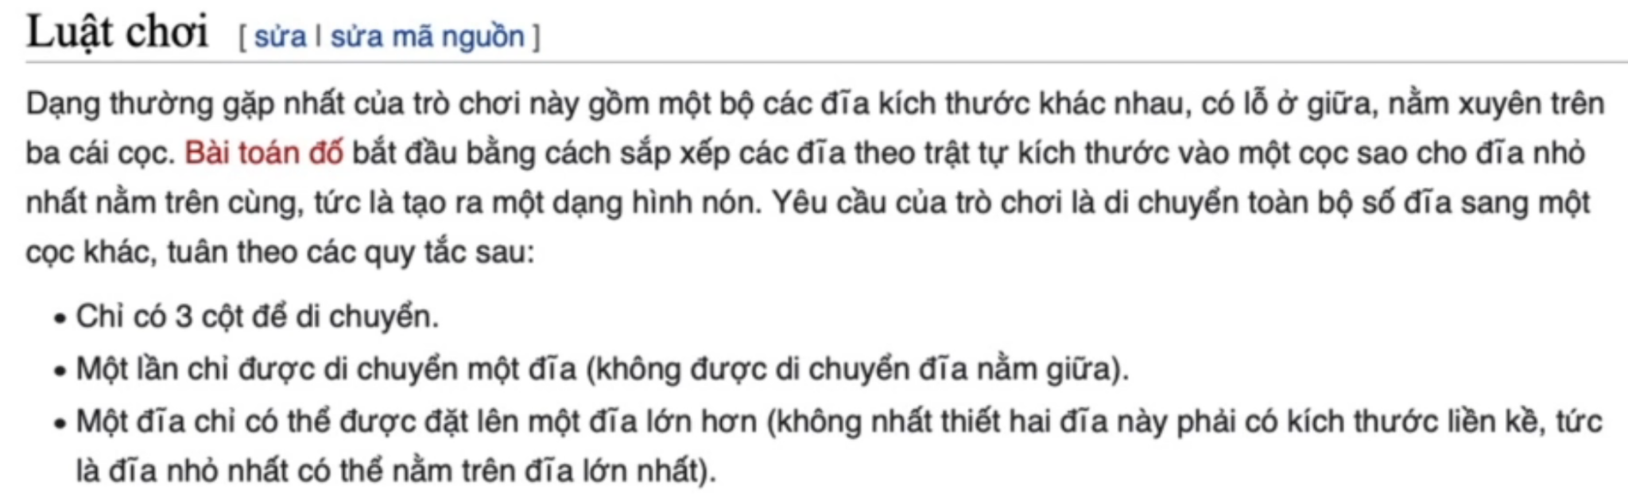
Tháp hà nội

Slide 25
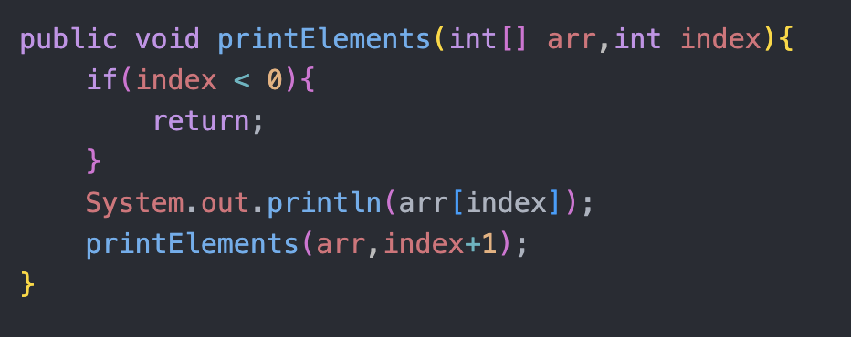
Phân loại đệ quy
> In ra giá trị của một mảng số nguyên

Slide 26
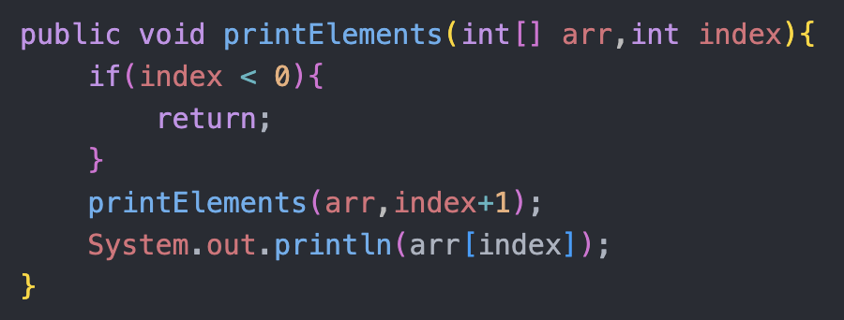
Phân loại đệ quy

Slide 27
Phân loại đệ quy
> Dựa theo logic bài toán và lời gọi hàm
> Đệ quy thực hiện công việc trước
> Đệ quy thực hiện công việc sau

Slide 28
Ưu điểm và nhược điểm đệ quy
Ưu điểm :
> ngắn gọn , dễ hình dung
> dễ cài đặt
Nhược điểm :
> Dễ gây StackOverflow
> Tốn hiệu năng về mặt thời gian và không gian bộ nhớ

Slide 29
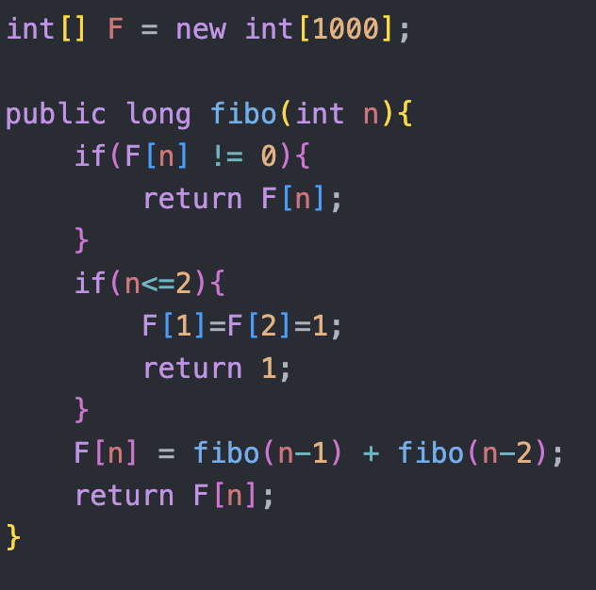
Tối ưu hóa đệ quy
> Đệ quy có nhớ :
Lưu lại kết quả được tính trước đó

Slide 30
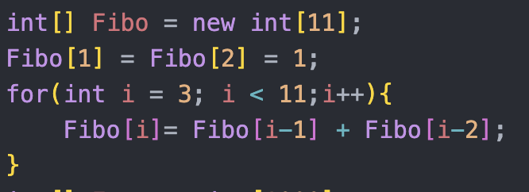
Khử đệ quy
Tìm cách giải bài toán mà không sử dụng đệ quy

Slide 31
Khi nào sử dụng đệ quy ?
> Không quan tâm đến hiệu năng ( thông thường dùng để test chức năng )
> Khi bạn chỉ biết làm mỗi cách đệ quy :v

Slide 32
2 cách cài đặt đệ quy
Phân loại :
> Có trả về kết quả
> Không trả về kết quả

Slide 33
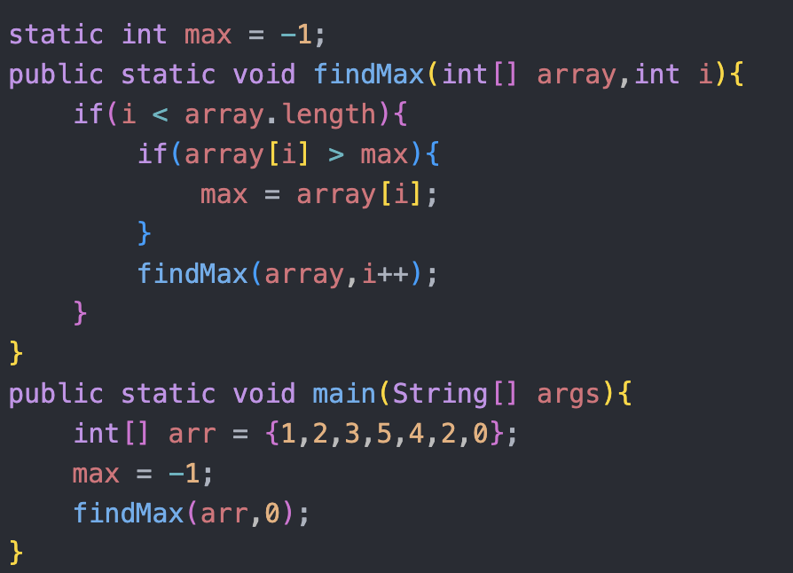
Tìm max trong một mảng

Slide 34
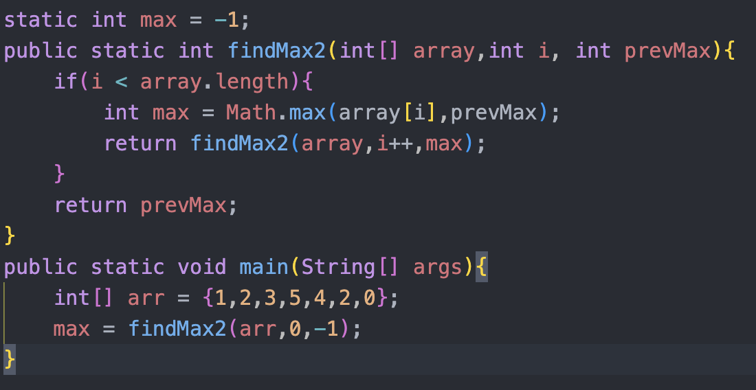
Return value

Slide 35
2 cách cài đặt đệ quy
> Không trả về kết quả
Áp dụng đc mọi bài toán ( nếu có sử dụng đệ quy )
Hay lưu kết quả ( dp, ad-hoc, … )
> Không trả về kết quả :
Áp dụng cho CTDL có tính đệ quy ( linked list, tree,... )
Ngắn gọn , sạch sẽ , dễ hiểu

Slide 36
Leetcode
#linkedlist
#recursion
#btree
#dp
#ad-hoc

Slide 37
Binary Search Tree
Các ví dụ thực tế :
> Tìm trang sách trang 89
> Tìm số báo danh trên 1 bảng thông báo

Slide 38
Ý tưởng :
Chia để trị
1
4
9
12
19
25
31
46
50
57
72
Find value 31

Slide 39
TABLE OF CONTENTS
01
02
03
04
05
06
INTRODUCTION
RESUME
COVER LETTER
MY WORK
PREVIOUS PROJECTS
OTHER

Slide 40
CONTENTS OF A PORTFOLIO
A portfolio is composed of three main elements:
Content: this includes the actual work you want to showcase and can be anything from writing samples to photographs or even videos
Design: the design should reflect your personality and style while remaining professional. It should also make it easy to navigate the portfolio
Summary: a brief summary at the beginning of the portfolio will help provide an introduction to your work and give visitors a better understanding of yourself and what you have created

Slide 41
THINGS TO INCLUDE IN YOUR PORTFOLIO
WORK SAMPLES
SKILLS
PROFESSIONAL NARRATIVE
Work samples can be anything from graphics to writing, videos or websites that showcase your design, development or the writing skills you have
Skills and qualifications are the credentials you have that show employers your experience and abilities in various areas that are related to your specific field
An overview of past project successes or other accomplishments as well as a summary of relevant knowledge and skills gained over the course of your professional career

Slide 42
02
RESUME

Slide 43

LISA JAMES
“I always strive for excellence. I believe in the power of collaboration, and I love to build meaningful relationships with clients throughout the creative process”
+34 654 321 432 | lisa@freepik.com
EXPERIENCE
EDUCATION
Now-2021
Marketing creator
Marketing agency
2010- 2014
Marketing degree
Communication
Writing
Leadership
Tracking and analyzing data to optimize campaigns
Coordinating promotional activities
2021-2016
Content creator
Creation studio
2016- 2017
Master’s in Graphic Design
Graphic design
Creativity
Curiosity
Creating videos, podcasts, graphics and infographics
Developing unique and engaging content
2016-2014
Team leader
Creation studio
2017- 2019
Master’s in Content Creation
Creativity
Adaptability
Management
Motivating and leading team members in tasks
Setting clear objectives and goals for the team

Slide 44
PREVIOUS PROJECTS
MARKETING
CONTENT CREATION PROJECTS
“I was responsible for managing campaigns across all major social media platforms; creating, curating and optimizing content for maximum engagement; analyzing data to gain insights into customer behavior and maintaining a strong relationship with customers”
“I have participated throughout my career in crafting SEO-friendly copy, creating promotional videos, designing newsletters and brochures and more. My work has been well received with several pieces being featured in prominent and important publications”

Slide 45
COVER LETTER
Slidesgo
+91 614 513 795
charlie@slidesgo.com
Welcome to my portfolio!
I'm [name], a highly creative and motivated individual, with a passion for [field of expertise]. My portfolio is filled with unique and inspiring content, which showcases my skills in the field.
Here you will find everything ranging from writing samples, photographs, videos and more. I strive for excellence in all that I do, and this portfolio serves as a testament to my capabilities and accomplishments.
Have a look around, get to know me better, and don't hesitate to reach out if you have any questions or would like to collaborate!
Sincerely,
LISA JONES
+91 620 421 838 | lisa@freepik.com

Slide 46


PHOTO SHOWCASE
This photo showcase is a collection of stunning images, each capturing a unique moment in time. Let them inspire you!

Slide 47



MY BEST WORK
“As an artist, it's my job to capture the beauty, joy and emotion of the world around me. I strive to create something unique in each piece, combining technique and detail”

Slide 48

"CREATIVITY IS THE KEY TO UNLOCKING YOUR TRUE POTENTIAL"

Slide 49
WHAT PEOPLE SAY ABOUT ME
EMPLOYER 1
EMPLOYER 2
“I have been impressed by the quality, attention to detail and creative approach brought to every project made”
“Projects and campaigns are always taken to another level with ideas that come from this person. Digital marketing and content creation experience is quite evident”
EMPLOYER 3
EMPLOYER 4
“This person has a strong technical understanding in order to develop successful strategies. Highly recommended for any kind of project or task”
“Content creation is top-notch, with engaging yet professional writing style tailored to different audiences while keeping a steady brand message”

Slide 50
MY SKILLS AND QUALIFICATIONS
LEADERSHIP
PROBLEM-SOLVING
COMMUNICATIONS
“I possess leadership abilities that have been sharpened through past roles where I was responsible for the teams”
“My problem-solving capabilities have enabled me to solve difficult issues in the past, using creative and innovative solutions”
“With excellent verbal and written skills, I can effectively convey complex messages to a variety of target audiences"
ORGANIZATION
TECHNICAL SKILL
INTERPERSONAL SKILLS
“My proactivity allows me to plan ahead and prioritize tasks according to objectives and different deadlines"
“I am knowledgeable in several technical areas such as programming languages that support my ambition in my specific field"
“Teamwork is one of the essential part of my daily job, and I am sensitive towards different cultures"

Slide 51
200
The number of projects I have worked on so far

Slide 52
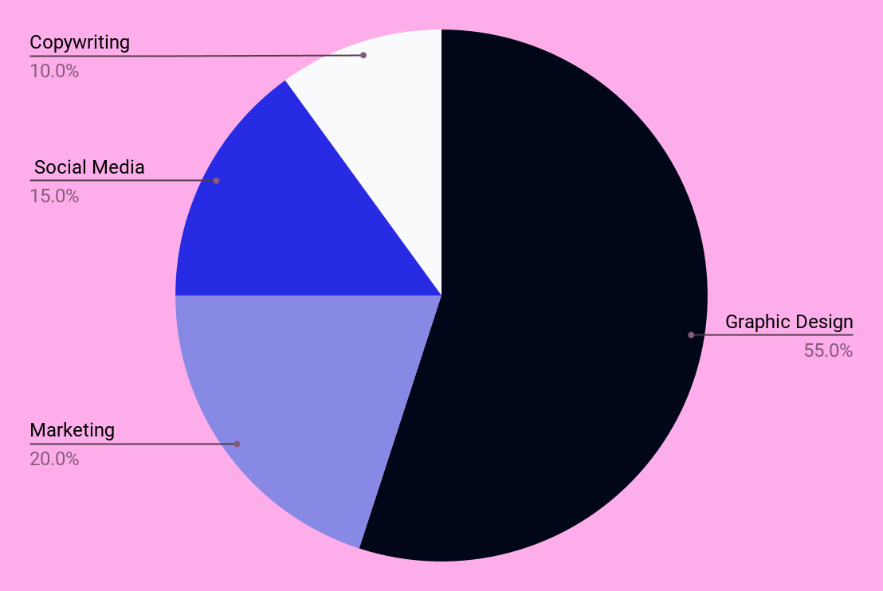
A CHART OF THE AREAS I WORK IN
55%
GRAPHIC DESIGN
Instagram, Twitter
20%
MARKETING
Promotion
15%
SOCIAL MEDIA
Illustrations, vectors
10%
COPYWRITING
SEO copywriting
Follow the link in the graph to modify its data and then paste the new one here. For more info, click here

Slide 53
TABLE
PROJECT TITLE | SKILLS | DATE | REFERENCE | CATEGORY
Project 1 | Graphic design | Jan 20XX | [Link or reference] | Print
Project 2 | Copywriting | Feb 20XX | [Link or reference] | Content
Project 3 | Video production | Mar 20XX | [Link or reference] | Motion
Project 4 | 3D modeling | Apr 20XX | [Link or reference] | 3D
Project 5 | UI/UX design | May 20XX | [Link or reference] | Web
Project 6 | HTML/CSS | Jun 20XX | [Link or reference] | Web

Slide 54
HOW DID I ACHIEVE SUCCESS?
STEP 1
STEP 4
Identifying objectives
Plans of action
STEP 2
STEP 5
Research and preparation
Measuring progress
STEP 3
STEP 6
Developing strategies
Continuous improvement

Slide 55
ROADMAP OF MY FUTURE PROJECTS
INITIATIVE | OBJECTIVE | JAN | FEB | MAR | APR | MAY | JUN | JUL | AUG | SEP | OCT | NOV | DEC
Developing a digital marketing strategy | Reach potential customers through well-crafted campaigns
Creating engaging content | Craft content that engages and inspires the target audience
Optimizing search rankings | Optimize for better and more visibility with SEO
Leveraging social media platforms | Connect with customers and boost brand awareness
Analyzing user habits | Gather user data to optimize design for more engagement
Executing email campaigns | Send emails to subscribers to convert leads into sales

Slide 56
THANKS!
Do you have any questions?
youremail@freepik.com
+91 620 421 838
yourcompany.com
Please keep this slide for attribution

Slide 57


ALTERNATIVE RESOURCES
Here’s an assortment of alternative resources whose style fits that of this template:
VECTORS
Watercolor tie dye background I
Watercolor tie dye background II
Flat acid emoji vertical poster template
Gradient rave party poster design

Slide 58
RESOURCES
Did you like the resources used in this template? Get them on these websites:
PHOTOS
Graphic designer making a logo on a notebook
Tie dye background I
Tie dye background II
Tie dye background III
Tie dye background IV
Tie dye background V
Tie dye background VI
VECTORS
Watercolor tie dye background I
Watercolor tie dye background II
Watercolor tie dye background III
Watercolor tie dye background IV
Landing page template for cyber monday sales

Slide 59
Instructions for use
If you have a free account, in order to use this template, you must credit Slidesgo by keeping the Thanks slide. Please refer to the next slide to read the instructions for premium users.
As a Free user, you are allowed to:
Modify this template.
Use it for both personal and commercial projects.
You are not allowed to:
Sublicense, sell or rent any of Slidesgo Content (or a modified version of Slidesgo Content).
Distribute Slidesgo Content unless it has been expressly authorized by Slidesgo.
Include Slidesgo Content in an online or offline database or file.
Offer Slidesgo templates (or modified versions of Slidesgo templates) for download.
Acquire the copyright of Slidesgo Content.
For more information about editing slides, please read our FAQs or visit our blog:
https://slidesgo.com/faqs and https://slidesgo.com/slidesgo-school

Slide 60
Instructions for use (premium users)
As a Premium user, you can use this template without attributing Slidesgo or keeping the Thanks slide.
You are allowed to:
Modify this template.
Use it for both personal and commercial purposes.
Hide or delete the “Thanks” slide and the mention to Slidesgo in the credits.
Share this template in an editable format with people who are not part of your team.
You are not allowed to:
Sublicense, sell or rent this Slidesgo Template (or a modified version of this Slidesgo Template).
Distribute this Slidesgo Template (or a modified version of this Slidesgo Template) or include it in a database or in any other product or service that offers downloadable images, icons or presentations that may be subject to distribution or resale.
Use any of the elements that are part of this Slidesgo Template in an isolated and separated way from this Template.
Register any of the elements that are part of this template as a trademark or logo, or register it as a work in an intellectual property registry or similar.
For more information about editing slides, please read our FAQs or visit our blog:
https://slidesgo.com/faqs and https://slidesgo.com/slidesgo-school

Slide 61
Fonts & colors used
This presentation has been made using the following fonts:
Inconsolata Bold
(https://fonts.google.com/specimen/Inconsolata)
Inconsolata Medium
(https://fonts.google.com/specimen/Inconsolata)
#020619
#fdaeea
#8889e5
#282be4
#f8fafb

Slide 62





Storyset
Create your Story with our illustrated concepts. Choose the style you like the most, edit its colors, pick the background and layers you want to show and bring them to life with the animator panel! It will boost your presentation. Check out how it works.
Pana
Amico
Bro
Rafiki
Cuate

Slide 63
Use our editable graphic resources...
You can easily resize these resources without losing quality. To change the color, just ungroup the resource and click on the object you want to change. Then, click on the paint bucket and select the color you want. Group the resource again when you’re done. You can also look for more infographics on Slidesgo.

Slide 66
JANUARY
FEBRUARY
MARCH
APRIL
MAY
JUNE
PHASE 1
Task 1
Task 2
PHASE 2
Task 1
Task 2
JANUARY
FEBRUARY
MARCH
APRIL
PHASE 1
Task 1
Task 2

Slide 69
...and our sets of editable icons
You can resize these icons without losing quality.
You can change the stroke and fill color; just select the icon and click on the paint bucket/pen.
In Google Slides, you can also use Flaticon’s extension, allowing you to customize and add even more icons.

Slide 70
Educational Icons
Medical Icons

Slide 71
Business Icons
Teamwork Icons

Slide 72
Help & Support Icons
Avatar Icons

Slide 73
Creative Process Icons
Performing Arts Icons

Slide 74
Nature Icons

Slide 75
SEO & Marketing Icons

Slide 76


